Slide 1
Effat University
NASA SPACE APPS CHALLENGE
(DISCOVERING SCIENCE CONNECTIONS)
THE GALAXY GEMS
DR ZAIN BALFAGIH
DR MOHAMED MAHEES
ASRA YAQUB
LAMAR HEJAZI
SARA SOFTAH

Slide 2
GALAXY GEMS (The Prism of Discovery)
OPPORTUNITY
PROBLEMS
Difficulty of finding points between different sciences
Lack of simulators for "What if" questions
Solving the issues
Scholars are not always available to answer our mysterious (and may be silly) questions
.

Slide 3
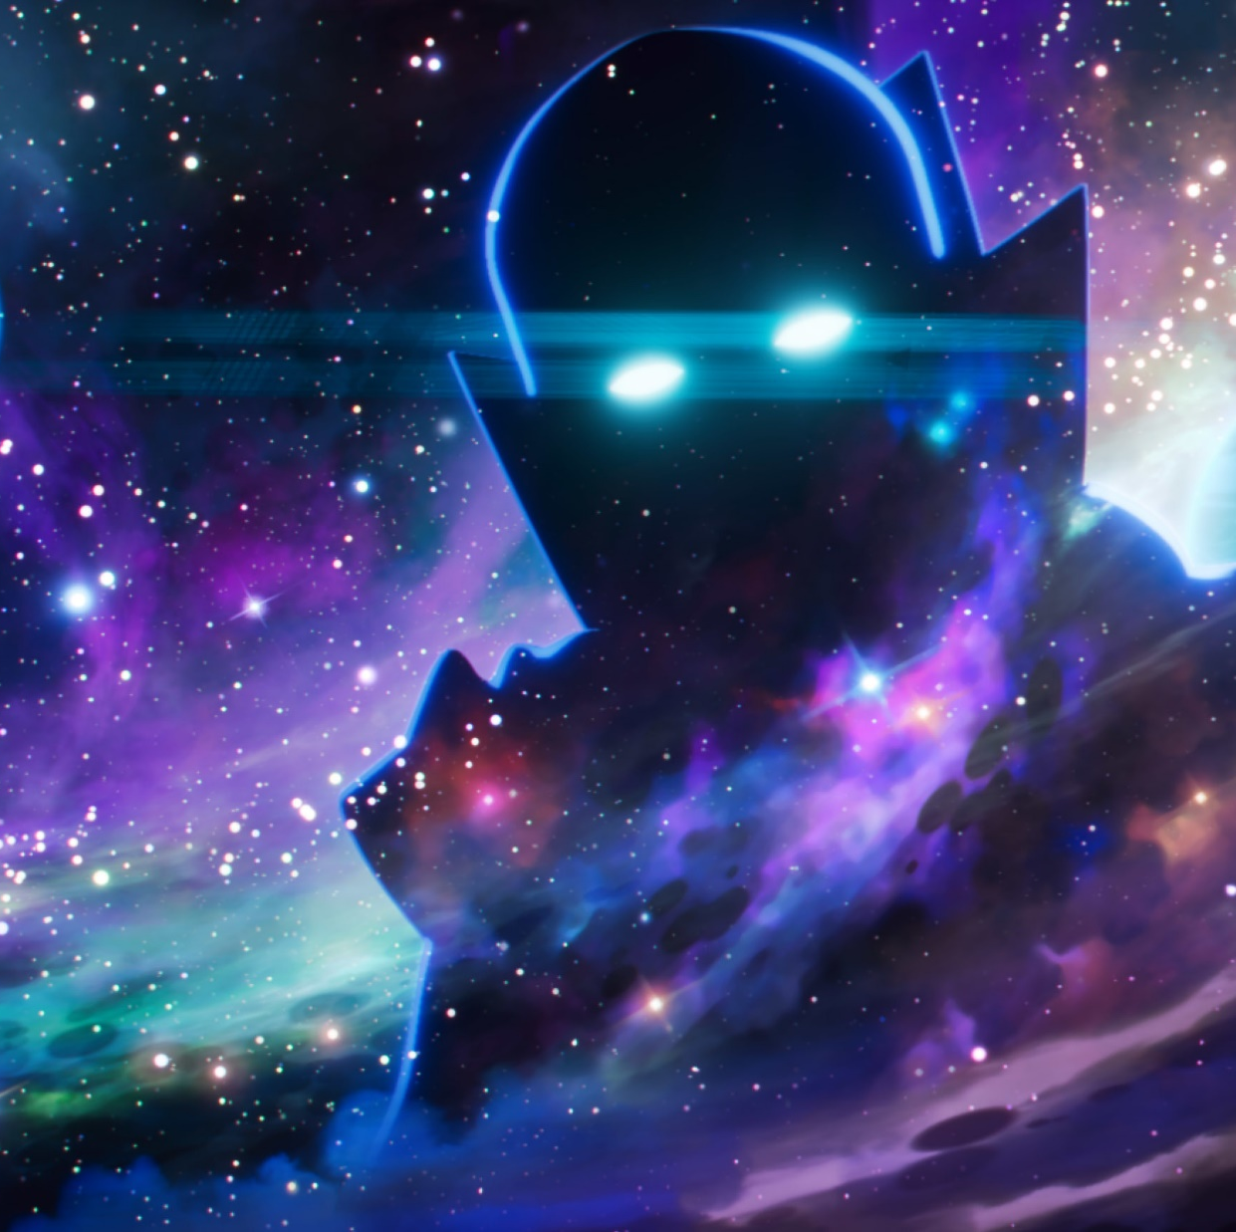

Inspiration

Slide 4
Inspiration
ANT COLONY OPTIMIZATION ALGORITHMS

Slide 5
GALAXY GEMS (The Prism of Discovery)
Mobile Application
What if Simulator
Cool Facts and Trivia
3D Explorer
Science Stories
Related Resources
Live Stats
Chat Bot Assistant

Slide 6
A mobile app that builds on NASA SMD
Explore possible connections based on your curiosity
Ask creative questions and get an answer
WHY
Galaxy
Dive (literally) in different sciences with a 3D simulator
Be updated on cutting-edge research and provide potential ideas for scientists
Gems?

Slide 7
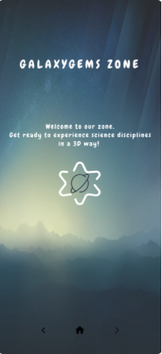
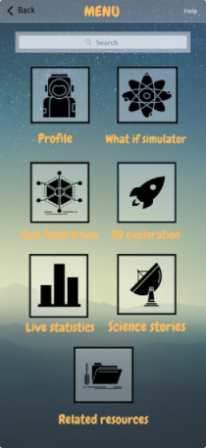
Application Glimpse
Home Page
Menu Page

Slide 8
Thank you
From the Galaxy Gems <3

